Slide 1


Database System
Management
Report Date- June 2, 2000
Confidential

Slide 2
Database Management
Project Objective:
The scope of our review was designed to identify and test key control mechanisms within ENA’s Oracle, Sybase, and Microsoft SQL Server database environment in accordance with the 2000 Business Audit Plan. Our audit procedures included interviews with key ENA personnel, review and assessment of available policy and procedure documentation and appropriate levels of testing necessary to identify strengths and weaknesses related to the existing control environment.
AA Team Members: Enron Team Members:
Tom Bauer Beth Perlman
Ed Hill Andrew Parsons
Michael Schultz Scott Williamson
Cindy Davis SooLian Irving
Russ Bouwhuis Jim Ogg
Amy Murphy Judy Rose

Slide 3
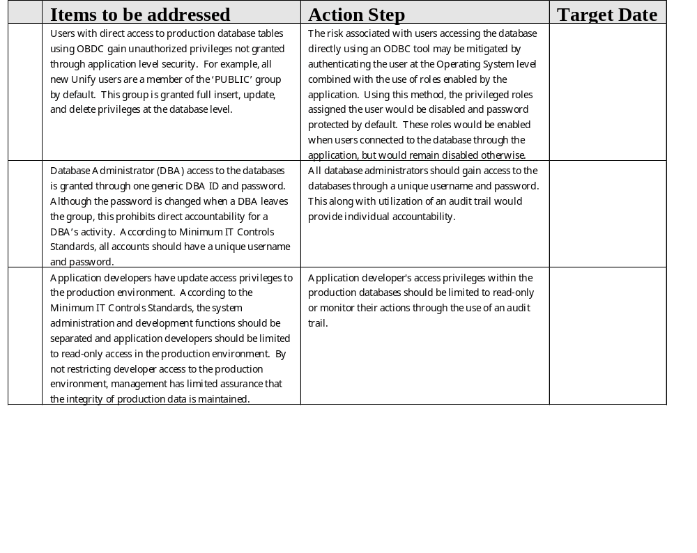
Database Management Observations
A
B
C

Slide 4
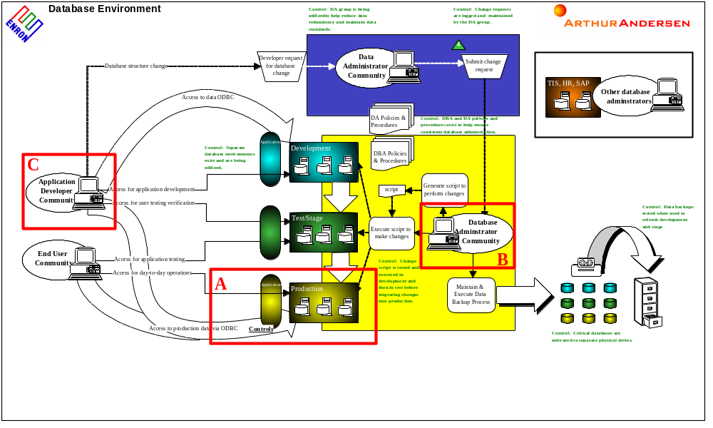
Database Management

